Slide 1













SRC 白帽子技术沙龙
2018年12月28日 | 上海
主办方
联合主办方
协办方

Slide 2

自我介绍
WiFi万能钥匙
常用ID 葫芦娃
Github：github.com/hluwa

Slide 3

Frida是啥？
Frida是一套目前最热门的动态测试框架，其最核心的功能就是Hook！

Slide 4
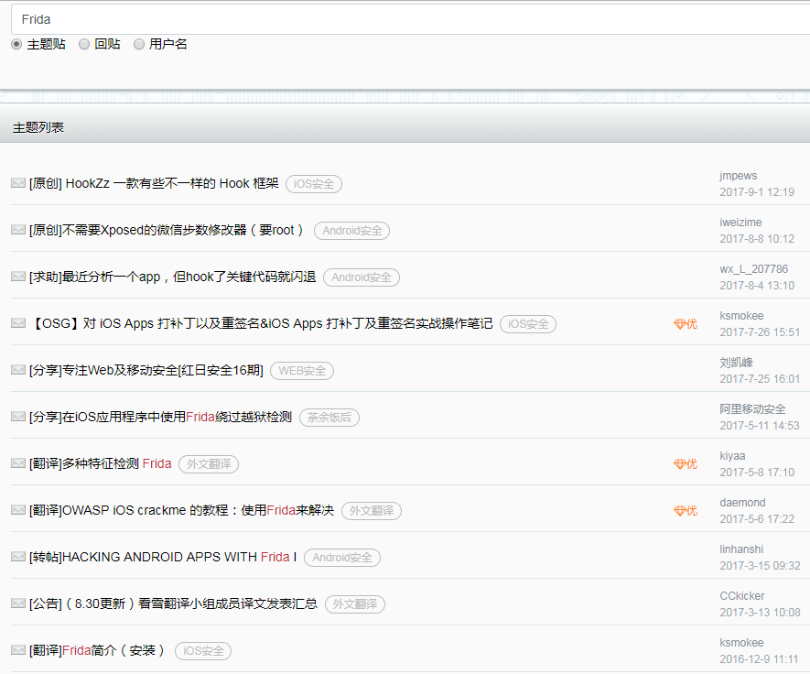
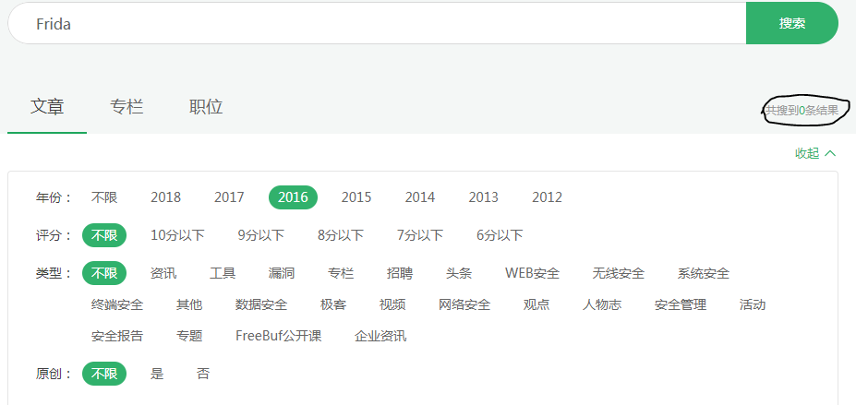
Frida有多火？
国内社区17年之前相关的资料≈没有

Slide 5
Frida有多火？
Frida部分选取了Github中JavaScript + Python的仓库数
Xposed部分选取了Github中Java的仓库数

Slide 6
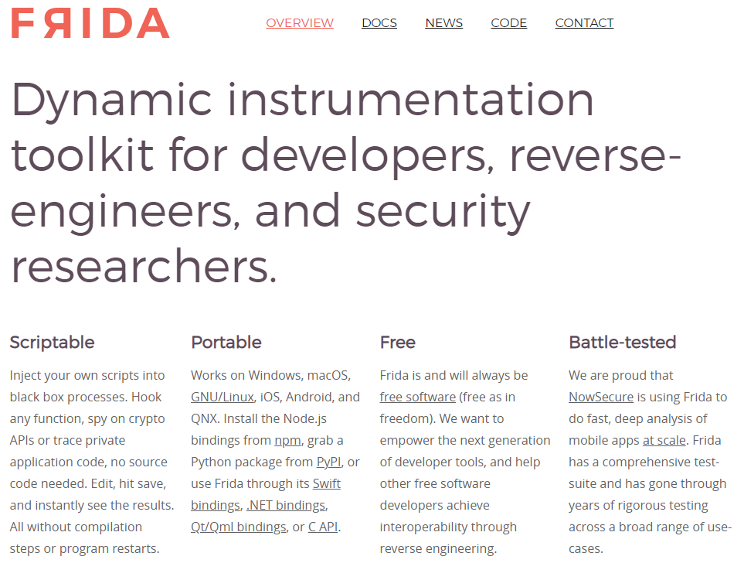
广度-适用范围
开发
逆向
渗透

Slide 7
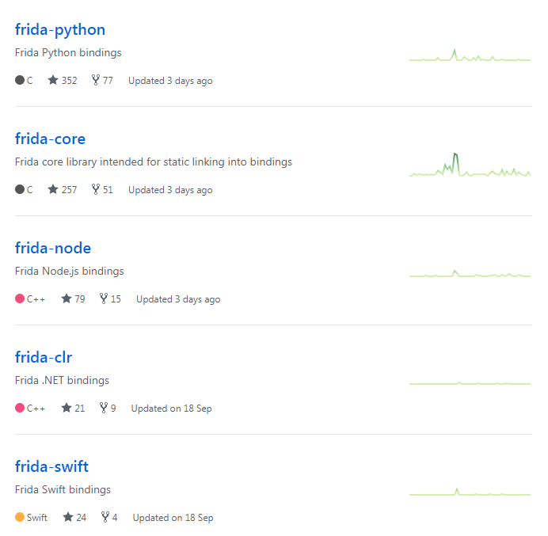
广度-支持多语言
Command Line Interface
JavaScript
Python
Swift
.NET
C/C++
QT(QML)

Slide 8
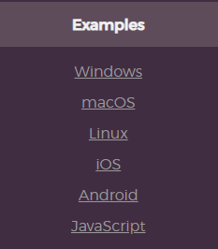
广度-跨六大平台
Windows
Linux
Android
iOS
MacOS
Node.js

Slide 9
效率
修改一行代码
编译
安装
重启
运行APP
Xposed

Slide 10
效率
运行Frida
运行APP
修改代码
运行代码
Frida节省下来的时间四舍五入就是一个亿啊！

Slide 11
强悍
跨度广
横跨六大平台
能力强
支持Native Hook是常规操作
效率高
Android上的Java Hook也OjbK
动态脚本语言
无需编译，随写随Hook
无需重启，随时reload脚本
支持免root模式（gadget）
支持多款语言
自带工具包
Frida-ps
Frida-trace
Frida-kill
Frida-discover
Frida-ls-devices
超强扩展
BurpSuite + Frida = Brida
Radare2 + Frida = r2Frida
Cycript + Frida = frida-cycript
……

Slide 12
能不能来点实际的?！!！

Slide 13
Sample – Java Hook
import frida
import sys
def get_messages_from_js(message, data):
print(message)
print (message['payload'])
hook_code =
"""
Dalvik.perform(function () {
var WebView = Dalvik.use("android.webkit.WebView");
WebView.loadUrl.overload("java.lang.String").implementation = function (s) {
send(s.toString());
this.loadUrl.overload("java.lang.String").call(this, s);
};
});
"""
process = frida.get_usb_device().attach(package_name)
script = process.create_script(hook_code)
script.on('message',get_messages_from_js)
script.load()
sys.stdin.read()

Slide 14
Sample – Native Hook
import frida
import sys
def get_messages_from_js(message, data):
print(message)
print (message['payload'])
hook_code =
"""
Interceptor.attach (Module.findExportByName ( "libc.so", "read"), {
onEnter: function (args) {
send (Memory.readUtf8String (args [1]));
},
onLeave: function (retval) {
}
});
"""
process = frida.get_usb_device().attach(package_name)
script = process.create_script(hook_code)
script.on('message',get_messages_from_js)
script.load()
sys.stdin.read()

Slide 15
尼玛不要纸上谈兵啊！！！

Slide 16

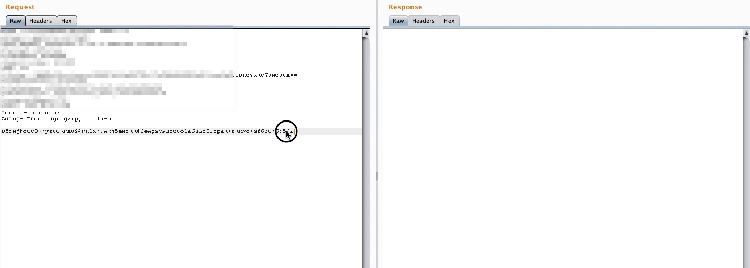
Brida
Brida是一个Burp Suite的扩展程序，它就是一道连接Frida和Burp的桥梁，让你可以在Burp中对APP进行插桩测试，甚至可以利用直接调用APP中的加解密函数来对请求包进行加密解密。
Brida = BurpSuite + Frida

Slide 17
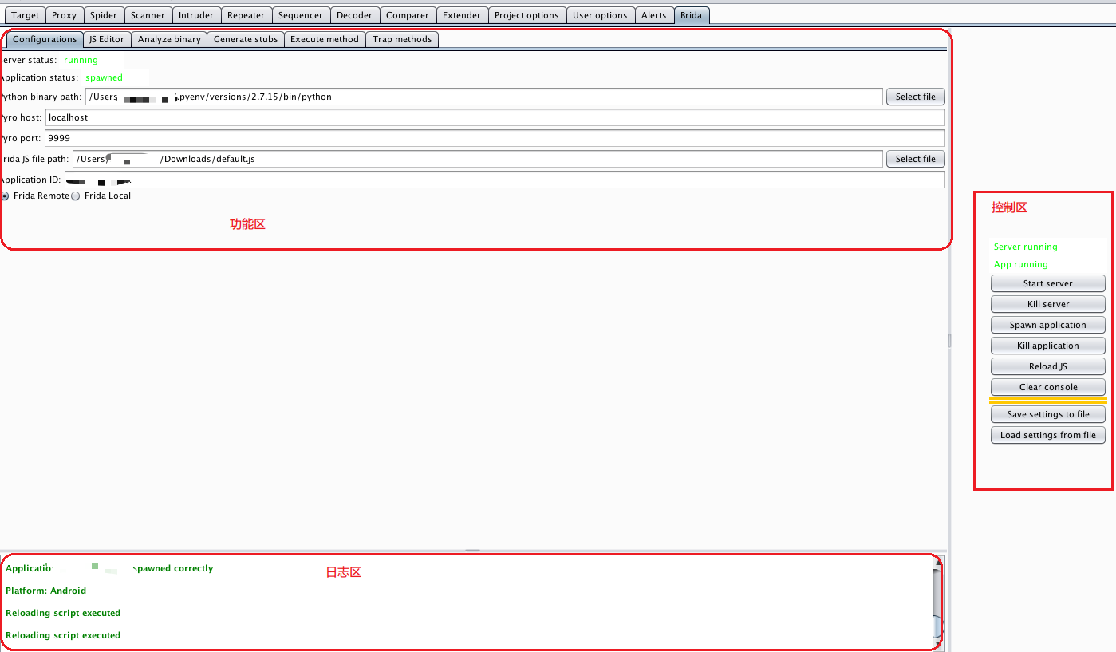
Brida

Slide 18
Brida – call crypto
contextcustom1: function(message) {
var res = "decrypt faild";
var input = hexToString(message);
Java.perform(function() {
res = Java.use("***.crypto.***").decrypt(input);
});
return stringToHex(res);
},
contextcustom2: function(message) {
var res = "encrypt faild";
var input = hexToString(message);
Java.perform(function() {
res = Java.use("***.crypto.***").encrypt(input);
});
return stringToHex(res);
},
contextcustom3: function(message) {
var res = "decrypt faild";
var input = hexToString(message);
Java.perform(function() {
res = Java.use("***.crypto.***").decrypt(input);
});
return stringToHex(res);
},

Slide 19
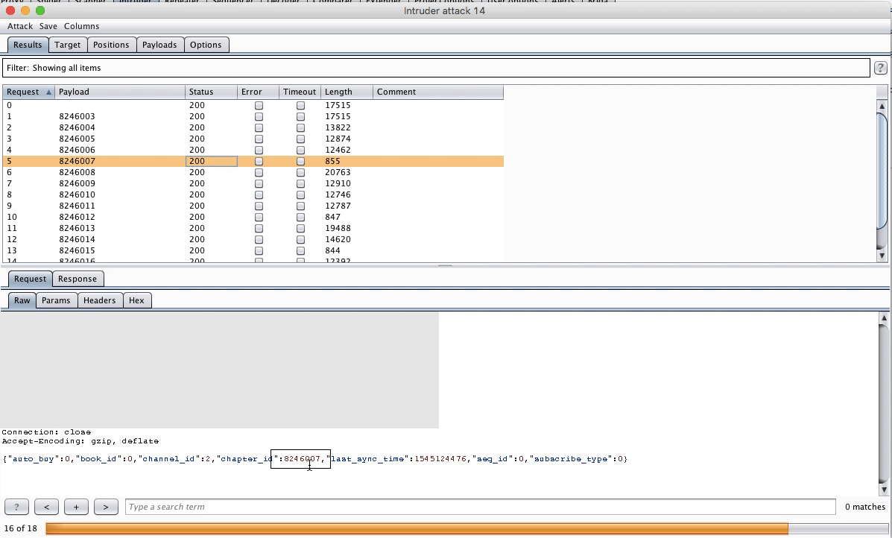
Brida
手动加解密算个咋回事！我想要的明明是这种可以哒哒哒的操作。。。

Slide 20
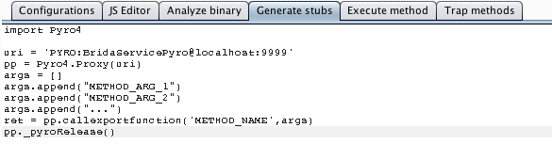
Brida – Proxy
import Pyro4
uri = 'PYRO:BridaServicePyro@localhost:9999'
pp = Pyro4.Proxy(uri)
args = []
args.append("METHOD_ARG_1")
args.append("METHOD_ARG_2")
args.append("...")
ret = pp.callexportfunction('METHOD_NAME',args)
pp._pyroRelease()

Slide 21
Brida - Proxy
Repeater
EncryptText
App Server
PlainText
Proxy
PlainText
EncryptText
Android Phone
Frida
Server
Android APP
Burp
Brida
Frida
Encrypt or Decrypt

Slide 22
Brida – Proxy
def decrypt(self, RequestOrResponse,raw):
body = raw[RequestOrResponse.getBodyOffset():]
newbody = body.tostring()
args = []
args.append(newbody.encode('hex'))
ret = pp.callexportfunction('contextcustom3',args)
ret = self._helpers.bytesToString(ret).decode('hex')
return self._helpers.buildHttpMessage(RequestOrResponse.getHeaders(), ret)
def encrypt(self, RequestOrResponse,raw):
body = raw[RequestOrResponse.getBodyOffset():]
newbody = body.tostring()
args = []
args.append(newbody.encode('hex'))
ret = pp.callexportfunction('contextcustom2',args)
ret = self._helpers.bytesToString(ret).decode('hex')
return self._helpers.buildHttpMessage(RequestOrResponse.getHeaders(), ret)
def processHttpMessage(self, toolFlag, messageIsRequest, messageInfo):
if toolFlag == 64 or toolFlag == 16 or toolFlag == 32: # TOOL_REPEATER TOOL_SCANNER TOOL_INTRUDER
request = messageInfo.getRequest()
analyzedRequest = self._helpers.analyzeRequest(request)
headers = analyzedRequest.getHeaders()
if not is_traget(headers, "***.***.com"):
return
if not messageIsRequest:
response = messageInfo.getResponse()
analyzedResponse = self._helpers.analyzeResponse(response)
messageInfo.setResponse(self.decrypt(analyzedResponse, response
else:
messageInfo.setRequest(self.encrypt(analyzedRequest, request))

Slide 23
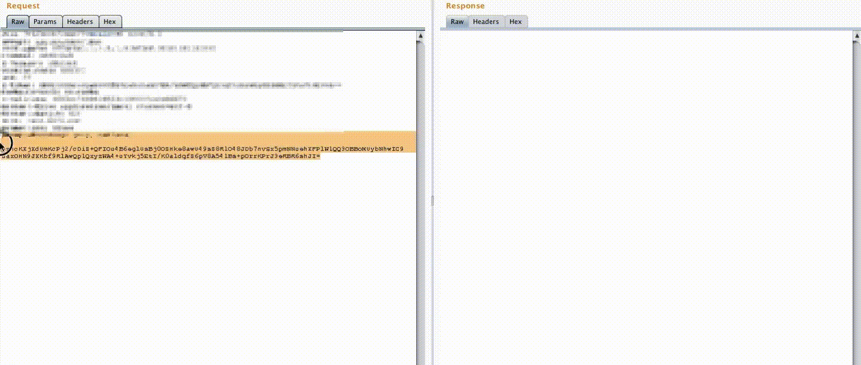
Brida – 最终效果

Slide 24
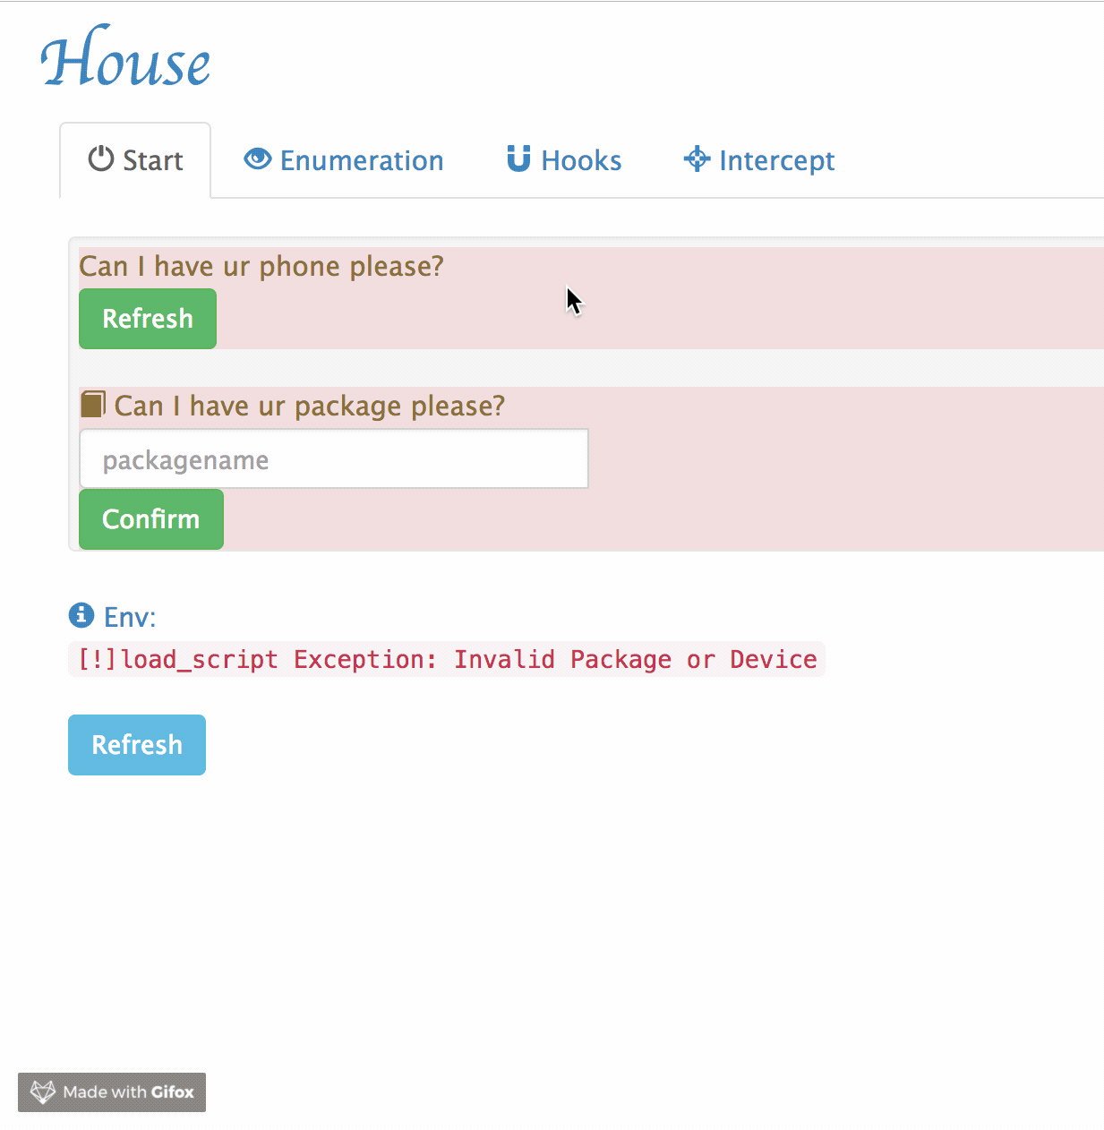
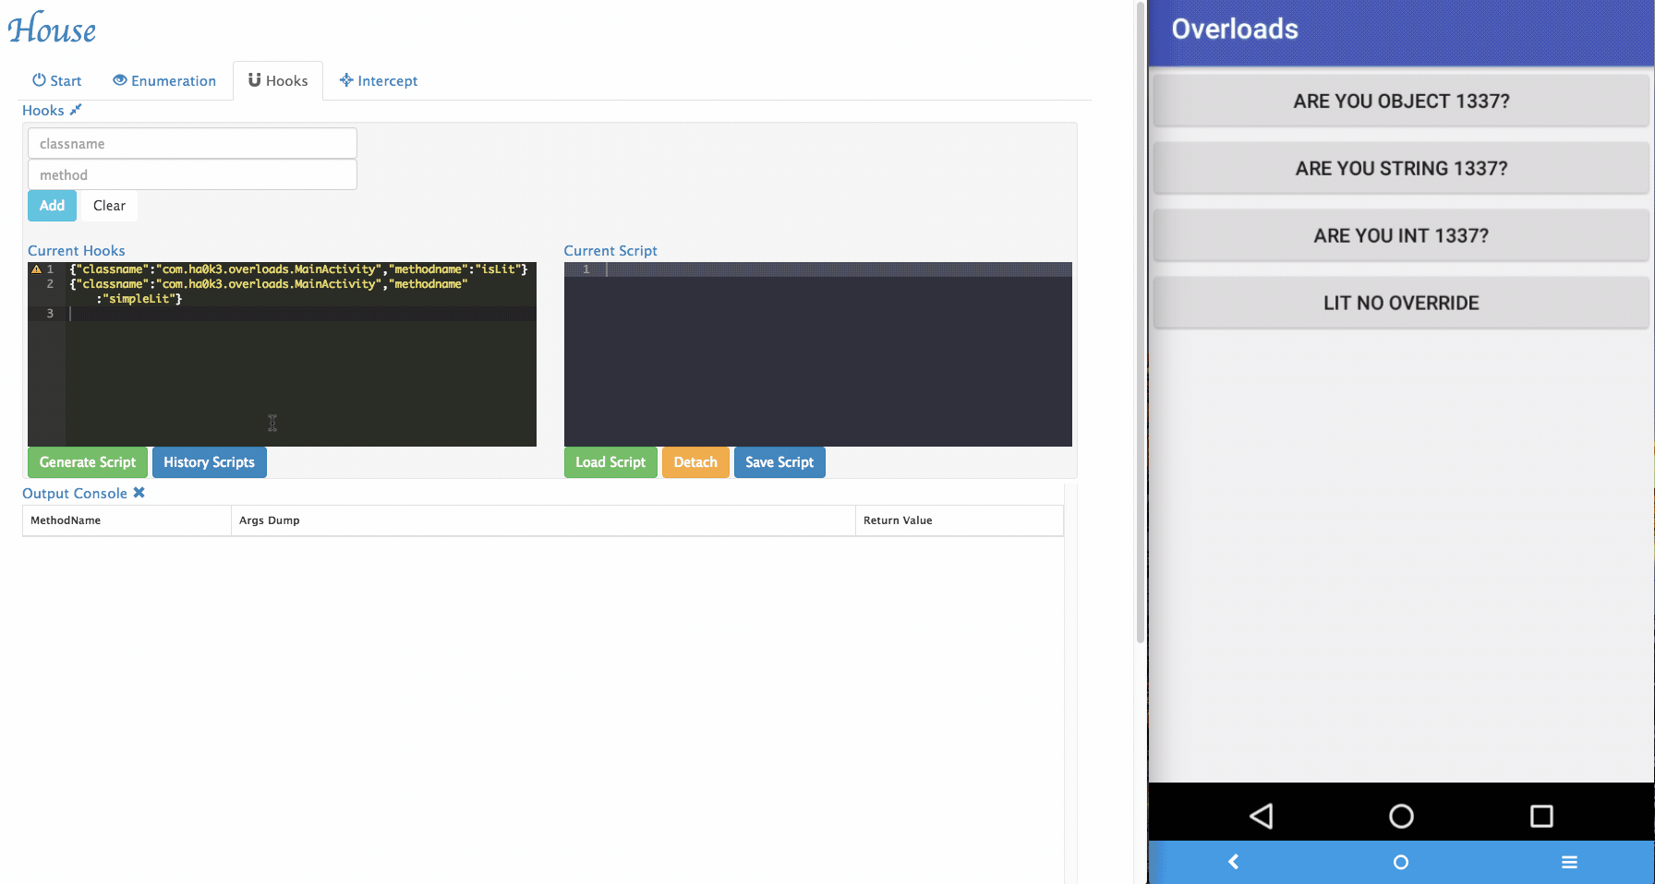
House
House是一套基于Frida二次开发的Android应用分析程序，最大的亮点就是人家有Web控制台。
https://github.com/nccgroup/house

Slide 25
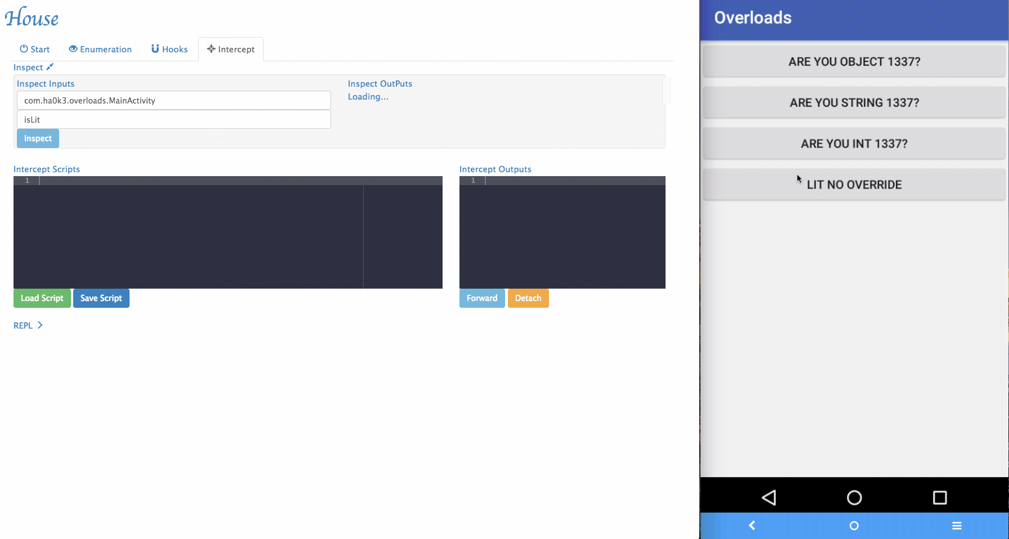
House - Intercept

Slide 26

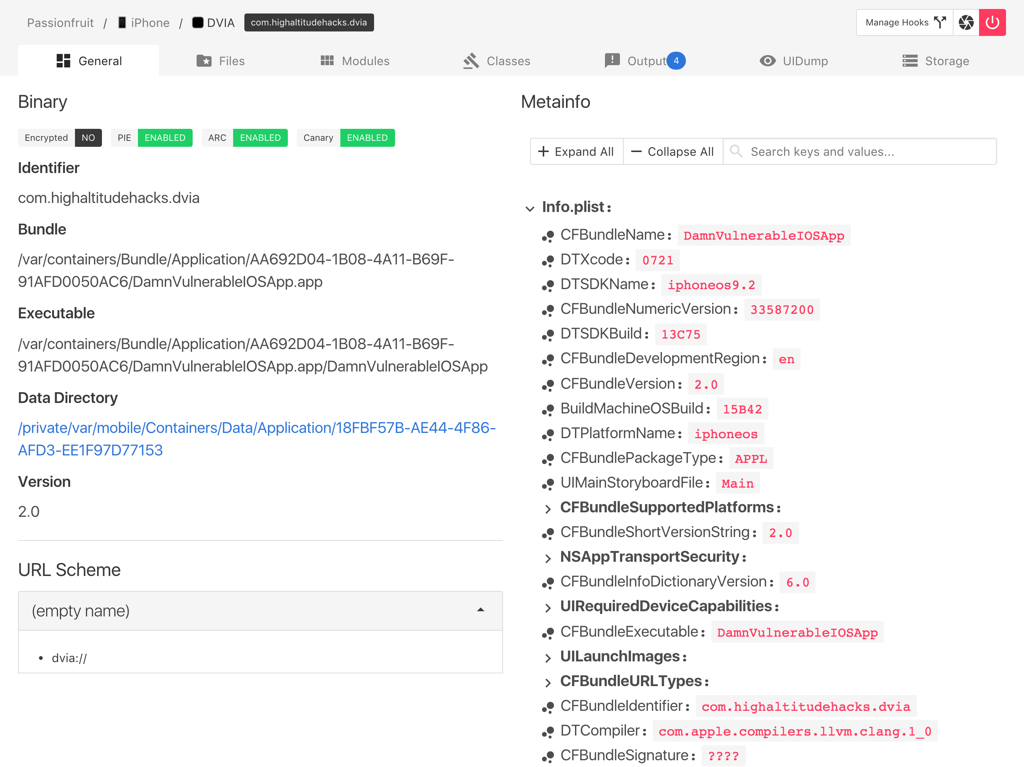
PassionFruit
一套基于Frida二次开发的iOS黑盒评估工具

Slide 27
PassionFruit
Features
Cross plarform web GUI! （GUI真香！）
Also supports non-jailbroken device (see Non-jailbroken device).
List all url schemes.
Check signature entitlements.
List human readable app meta info (Info.plist).
Capture screenshot.
Checksec: see if target app is encrypted, and has enabled PIE, ARC and stack canary.
App sandbox file browser. Directly preview images, SQLite databases and plist files on device. You can always download the file for further investigation.
Check the loaded frameworks. Hook exported native functions from these dylib to print the arguments and stack trace.
Log SQLite operations.
Log and try to bypass jailbreak detection.
List Objective-C classes from app, hook the methods and inspect the arguments and stack trace.
Dump KeyChain, BinaryCookies and UserDefaults.

Slide 28
DWARF
一个使用PyQT写的Android调试工具，依赖于Frida实现。
https://github.com/iGio90/Dwarf

Slide 29
广泛应用
比如…挖个0day？
用Frida来fuzz safari(CVE-2018-4193)： https://blog.ret2.io/2018/07/25/pwn2own-2018-safari-sandbox/
再比如..爆破个CrackMe？
Frida爆破Windows程序中的应用： https://www.freebuf.com/articles/system/182112.html
辅助分析漏洞：
CVE-2017-4901 VMware虚拟机逃逸漏洞分析【Frida Windows实例】
https://bbs.pediy.com/thread-248384.htm
脱壳：https://github.com/dstmath/frida-unpack
跟踪函数调用：https://github.com/sangohan/frida-tracer
Hook都是常规操作：
https://github.com/antojoseph/frida-android-hooks
https://github.com/0xdea/frida-scripts
……

Slide 30
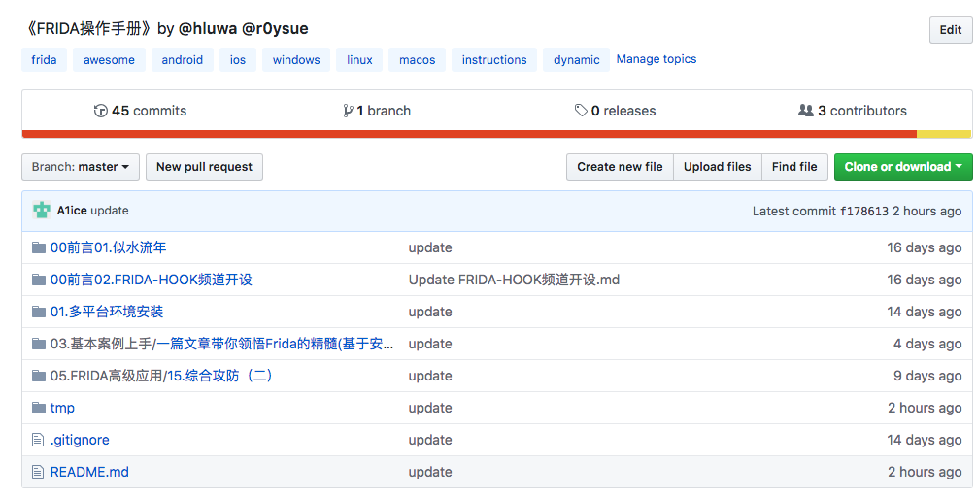
广而告之
https://github.com/hookmaster/frida-all-in-one

